Slide 1

GlobalGiving: Strategic Financial Benchmarking
GWU Consulting Team
Max Tanz
Ji Hoon Park
Aditya Gupta
Oscar Basil
Falguni Shah

Slide 2

Executive Summary
About GlobalGiving
Pioneering nonprofit crowdfunding platform founded over 20 years ago
Has raised and distributed nearly $1 billion to charities worldwide.
Known for:
Rapid international fund distribution
Scalable due diligence systems
Strong partnerships with Fortune 500 companies (e.g., Ford, Nike, Pepsi)
Project Objective
Goal: Develop a strategy to raise $1 billion over the next 3 years
Key Challenges
Revenue volatility (decline in marketplace/corporate donors)
Slower-than-expected growth in product offerings (e.g., Atlas)
Budget deficit due to decreased transaction/service fee income

Slide 3
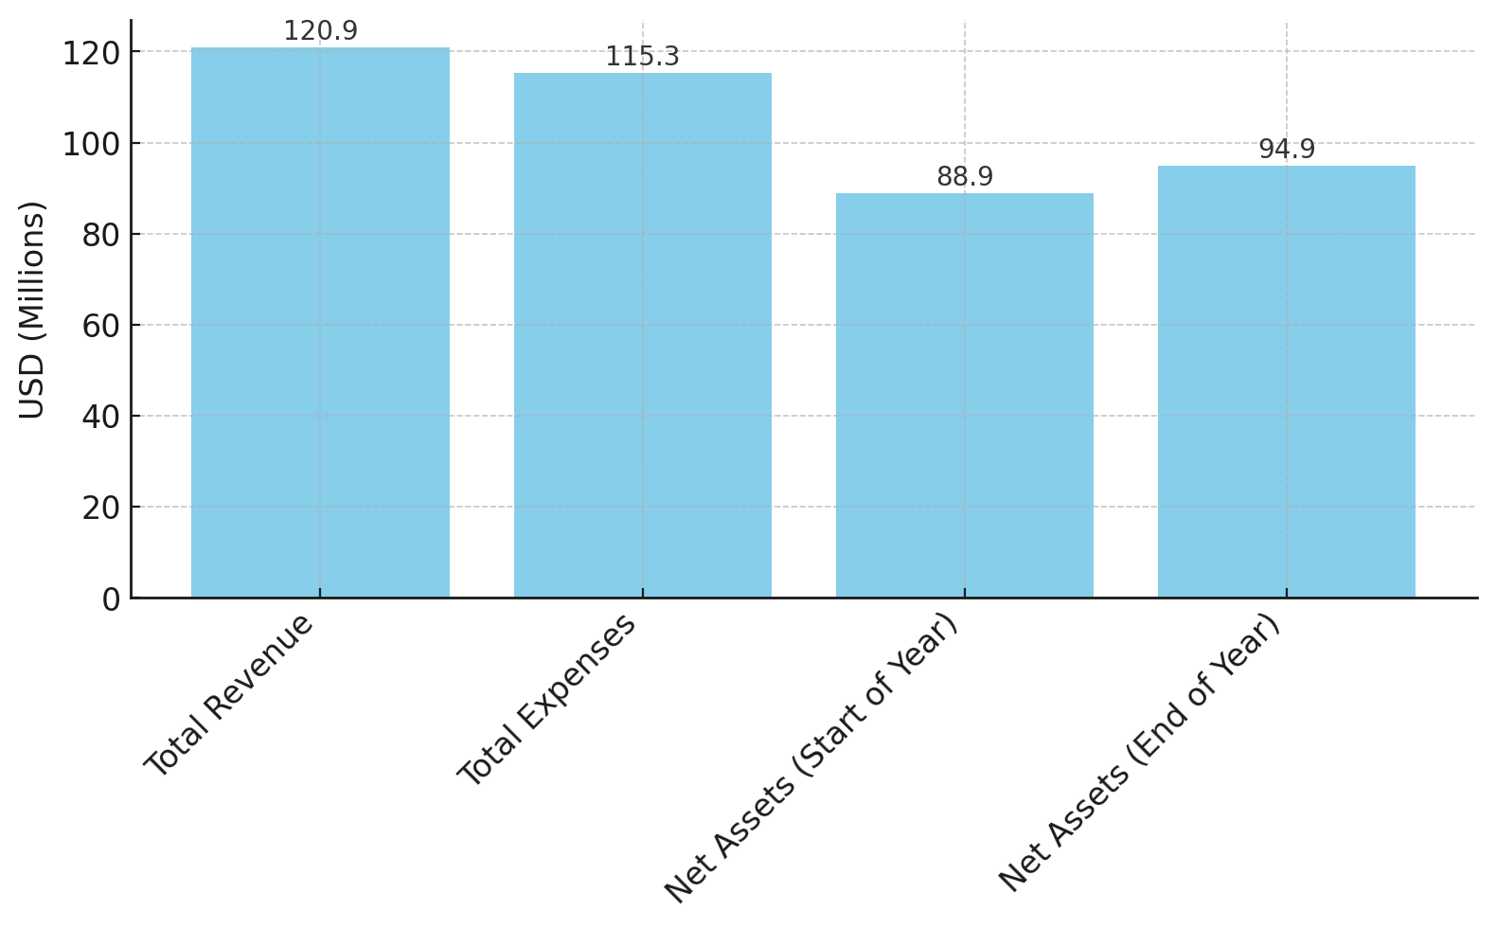
Financial Position
Balance Sheet (in USD millions)
Reconciliation of Net Assets (2023)
Metric | 2023 | 2022
Total Assets | 106.4 | 102.1
Total Liabilities | 10.4 | 12.0
Net Assets | 96.0 | 90.2
With Donor Restrictions | 83.5 | 74.6
Without Donor Restrictions | 12.5 | 15.6
Significant reduction in cash reserves due to allocation into investments ($88.6M -> $33.6M)
$83.2 million used for new investments in U.S. Treasuries and money market funds.

Slide 4
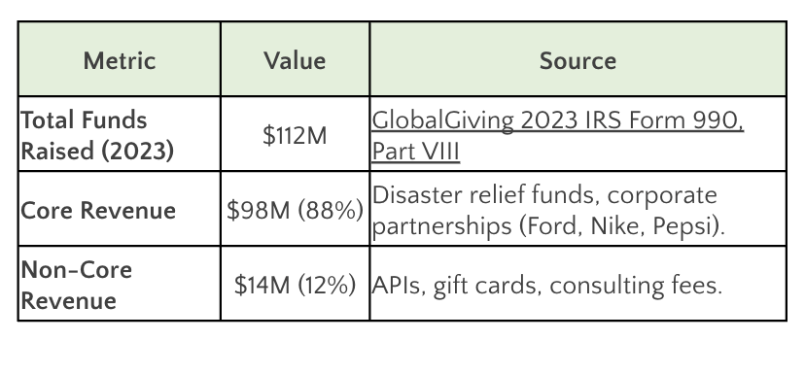
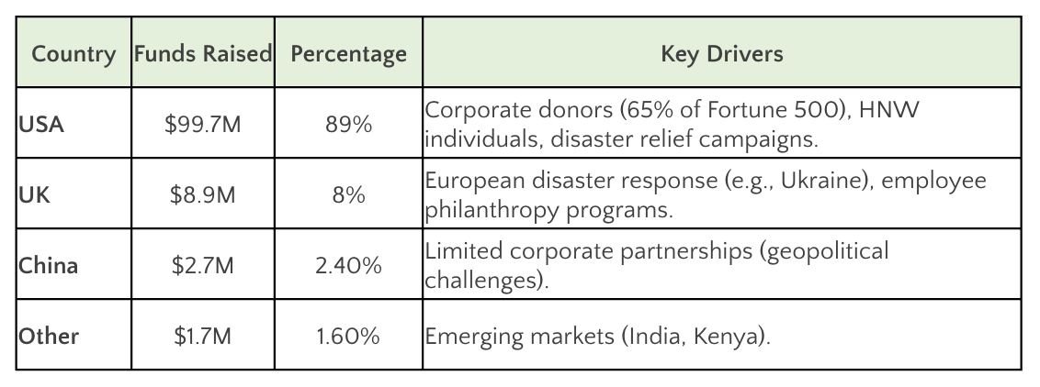
Top Line Items
2023 Breakdown: Core vs. Non-Core Sources
Geographic Distribution (2023)
Total Revenue decreased by $31 million YoY
Mainly due to a $34.73 million drop in project contributions.
Earned $1.72 million from investments
Salaries and benefits increased to $16.15 million (from $9.92 million in 2022)
Has Presence in 90+ Countries
Held over $1.19 million in cash and equivalents in foreign banks
Majority insured under the UK’s Financial Services Compensation Scheme

Slide 5
Competitor Landscape
Specialization
GoFundMe is the world’s largest crowdfunding platform with a strong brand and high campaign success rates, though newer platforms and transaction fees pose competitive challenges.
Myriad USA enables cross-border philanthropic giving through trusted partnerships and a robust global grantmaking network, but it has low brand visibility and limited direct donor engagement compared to public-facing platforms.
Every.org enables tax-deductible international giving with automation features like employer match, yet remains a niche player with limited global recognition.
Center for Disaster Philanthropy (CDP) specializes in disaster-focused philanthropy and holds strong NGO partnerships, but its revenue model is less diversified.
DonorsChoose excels in U.S. education projects through its teacher-led, high-engagement model but faces limitations due to its domestic focus and reliance on corporate grants.
GoodStack (Percent Impact) leverages a B2B corporate giving model with partners like HSBC and LinkedIn, though it is still in early growth stages and scaling operations.

Slide 6
Competitors Financials
Organization | Year | Contributions, Gifts, Grants | Program Service Revenue | Other Revenue | Total Revenue
GlobalGiving | 2023 | $3,136,000 | $12,000,000 | $2,481,000 | $17,617,000
DonorsChoose | 2023 | $153,640,236 | N/A | N/A | $153,640,236
CAF America | 2023 | $813,100,000 | $1,000,000 | $2,618,831 | $816,418,831
every.org | 2023 | $2,033,763 | $85,603 | $406,169 | $2,525,535
GoodStack | 2023 | $231,123 | N/A | N/A | $231,123
Myriad | 2023 | $117,672,211 | $2,771,584 | $3,500,476 | $123,944,271
CDP | 2023 | $33,309,167 | N/A | $1,199,345 | $34,508,512

Slide 7
Financial Ratios
Financial Ratios | Donors Choose | Charities Aid Foundation America | Every.org | GoodStack (est Percent) | Myriad | Center for Disaster Philanthropy | GlobalGiving
Liquidity Ratio | 22.9 | 88.1 | 106.5 | 15.6 | 4.4 | 15.3 | 10.3
Solvency Ratio | 0.03 | 0.03 | 0.10 | 0.1 | 0.3 | 0.1 | 0.2
Program Efficiency | 0.2 | 1.0 | 0.892 | 0.9 | 1.0 | 0.9 | 0.9
Fundraising Efficiency | 0.30 | 0.03 | 0.12 | 0.02 | 0.02 | 0.01 | 0.002
Revenue | $153.6M | $816.4M | $2.5M | $268K | $123.9M | $34.5M | $17.6M
Months of Operating Expenses Covered | 3.3 | 4.4 | 3.9 | 1.4 | 0.6 | 13.8 | 9.1

Slide 8
Few notable Challenges
Risk-Averse Approach
Highly Selective Criteria
Focus on Large-Scale Funding
Limited Promotional Strategy
Loss of a recent Corporate Partner

Slide 9
GlobalGiving Scaling
Internal (Within Company):
Retention of Existing Customers
Geographic Expansion
Marketing
Online Presence
Advertisement and Co-branding
Testimonies
Sponsors Branding
Other Lines of Business:
Consulting / Legal / Advisory
File Taxes / Event Management / Ticket Sales
Efficiency in Vetting Donors
Acquisition ($3–$10M target)
Recurring Payments
Account Management & Donor Relations
Donor Success Manager
External Opportunities (Funding Sources)
Government Collaborations
POS-Based Engagement.
University Partnerships
Foundation Funding
Donations
Individuals
SME/SMB Partnerships
Referrals

Slide 10
Strategic Implementation Timeline
Year 1: Foundation Building
Expand Fortune 500 partnerships (12 → 25), with a tech-sector focus
Launch high-net-worth donor tier ($100K+)
Boost digital fundraising via SEO, paid ads, influencers (target: $2.5M)
Deploy AI for donor targeting and blockchain for transparency
Hire fundraising, grants, and marketing specialists
Year 2: Scaling Impact
Launch $1M+ named endowments with custom reporting
Expand global reach (8 new languages; APAC/MEA focus)
Accelerate grant processing (60% faster via AI)
Launch peer fundraising; deepen foundation partnerships
Year 3: Sustainability & Growth
Launch $50M Impact Investment Fund (target return: 8–10%)
Diversify revenue via subscriptions, micro-loans, social impact bonds
Expand into emerging markets (Asia, Middle East, Africa)
Secure $75M from ESG-aligned institutional funds
Form partnerships with 5+ municipal governments

Slide 11
Resources & Financial Projections
Resources Required
Talent: Fundraising experts, grant writers, marketing strategists
Tech: AI-powered donor analytics
Marketing: Multi-channel campaigns, sponsorships, influencers
Investment: $50M+ across tech, operations, global scale-up
Projected Fundraising Impact
Year 1: $250M
Year 2: $350M
Year 3: $400M
Total (3 Years): $1B+ Raised
Increased nonprofit impact and financial sustainability

Slide 12
Conclusion
GlobalGiving is now entering a transformative phase, backed by a proven track record, a global presence, and trusted partnerships, it is uniquely positioned to scale its impact at an unprecedented level.
With focused investments, strengthened alliances, and operational excellence, GlobalGiving is well-prepared to realize its ambitious vision of raising $1 billion over the next three years, driving sustainable growth and amplifying global philanthropic impact.

